Slide 1
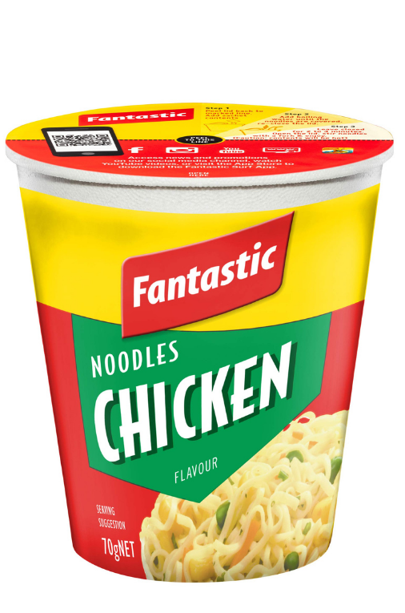
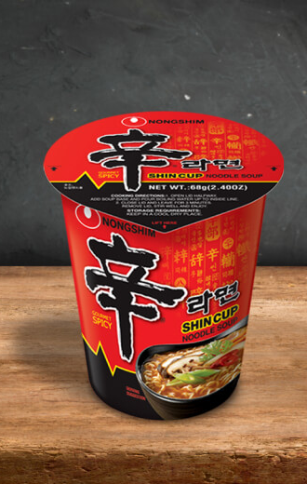
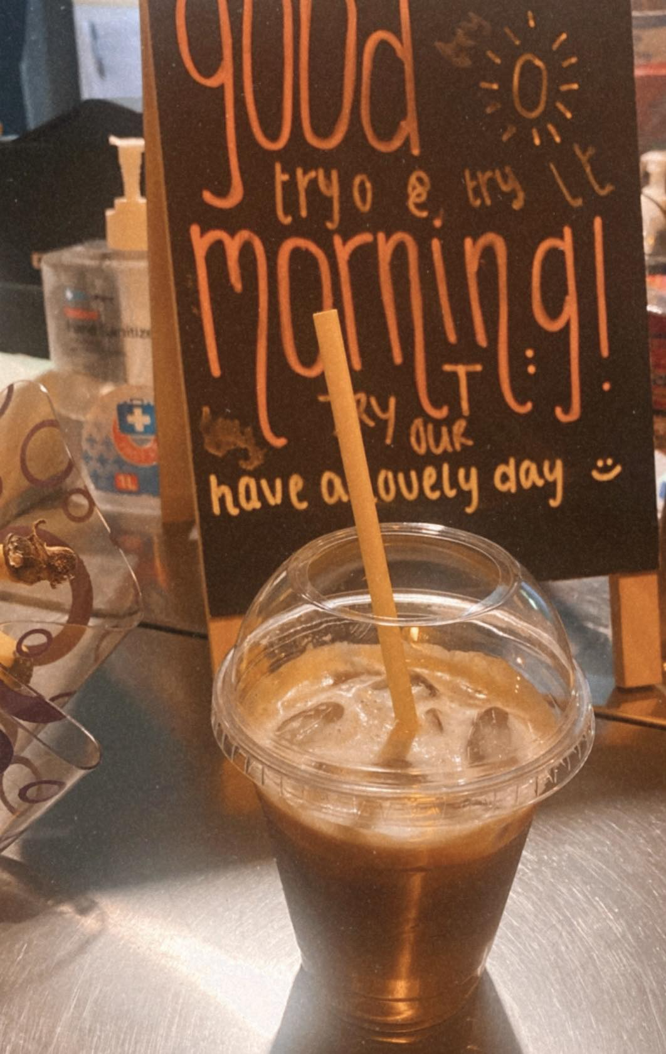
$3.50
$3.50
$6.50
Fantastic Chicken Noodle
Shin Spicy Noodle
Vietnamese Ice Coffee
*Noodle cups are $3 for student exclusively.

